Slide 1
The Foreign Language Effect and Correspondence Bias
Investigating Bilingual's Perceptions of Interpersonal Attributions

Slide 2
The foreign Language effect (FLE)
Bilingualism
FLE
Affects decision-making
Keysar et al., 2012
Underlying process
Dual-process framework
Two accounts
Increased time for deliberation
Decreased emotional resonance (most likely)
Cognitive biases
Causality bias
Self-serving bias

Slide 3
Correspondence Bias
Gap in literature
Why it occurs
Salience of individual vs circumstances
Dixon 2012
L1 Spanish and L1 English early bilinguals
Neglect of External Demand (NED)
Attitude-Attribution Paradigm
10 statements
7-point likert scale
Scopelliti et al., 2018
Fundamental Attribution Error

Slide 4
Research Question and hypothesis
Research Question:
Does the foreign language effect influence susceptibility to correspondence bias?
Hypothesis:
There will be a decrease in correspondence bias in the LX condition.

Slide 5
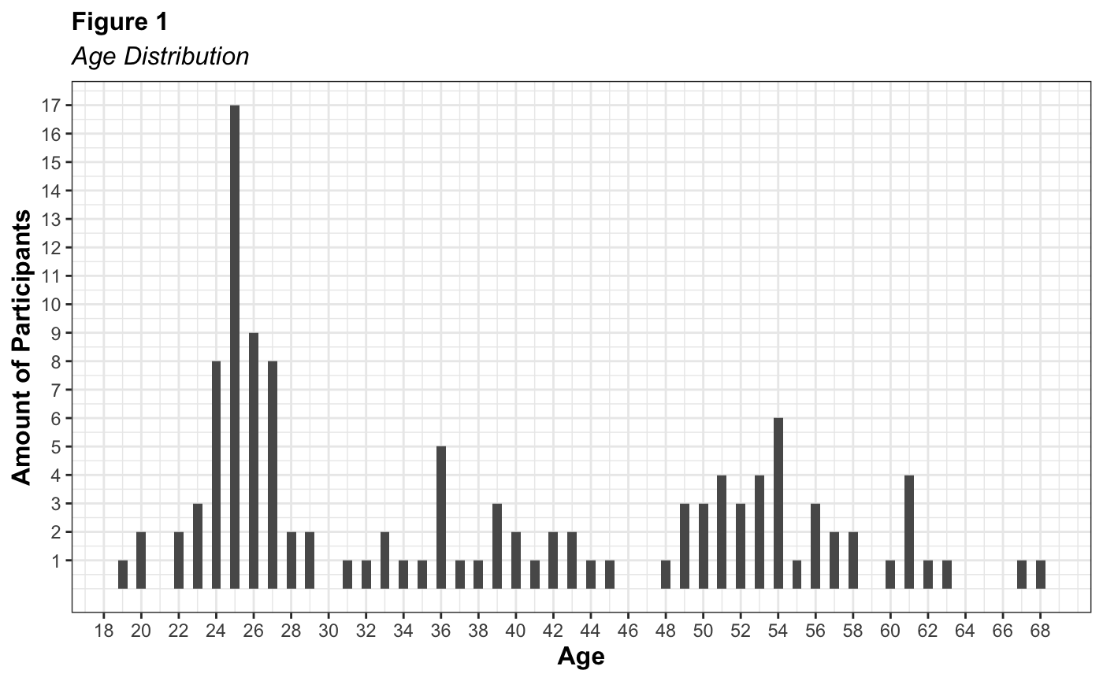
Methods
Participants
NED Scale
English Translation
LexTALE
English fluency
Procedure
Random allocation: Faroese or English
L1 Faroese Speakers
LX English
120 after exclusion criteria
Faroese Translation
LexTALE
Demographics

Slide 6
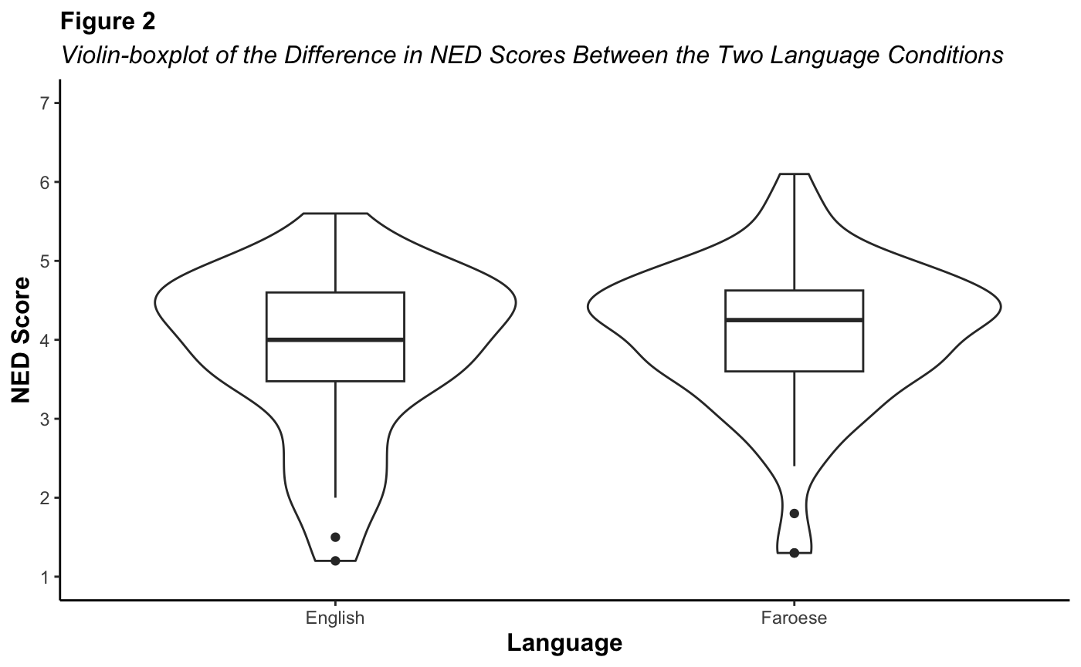
Results
Very similar scores, only slight difference
Cronbach’s Alpha
Faroese Scale = .67
NED Score ~ Language + LexTALE + Age of Acquisition
F(3, 116) = 1.56, p = .203, R² = 0.04, adj. R² = 0.01
Non-significant decrease
English: mean = 3.79, SD = .97
Faroese: mean = 4.04, SD = .94
Original = .83

Slide 7
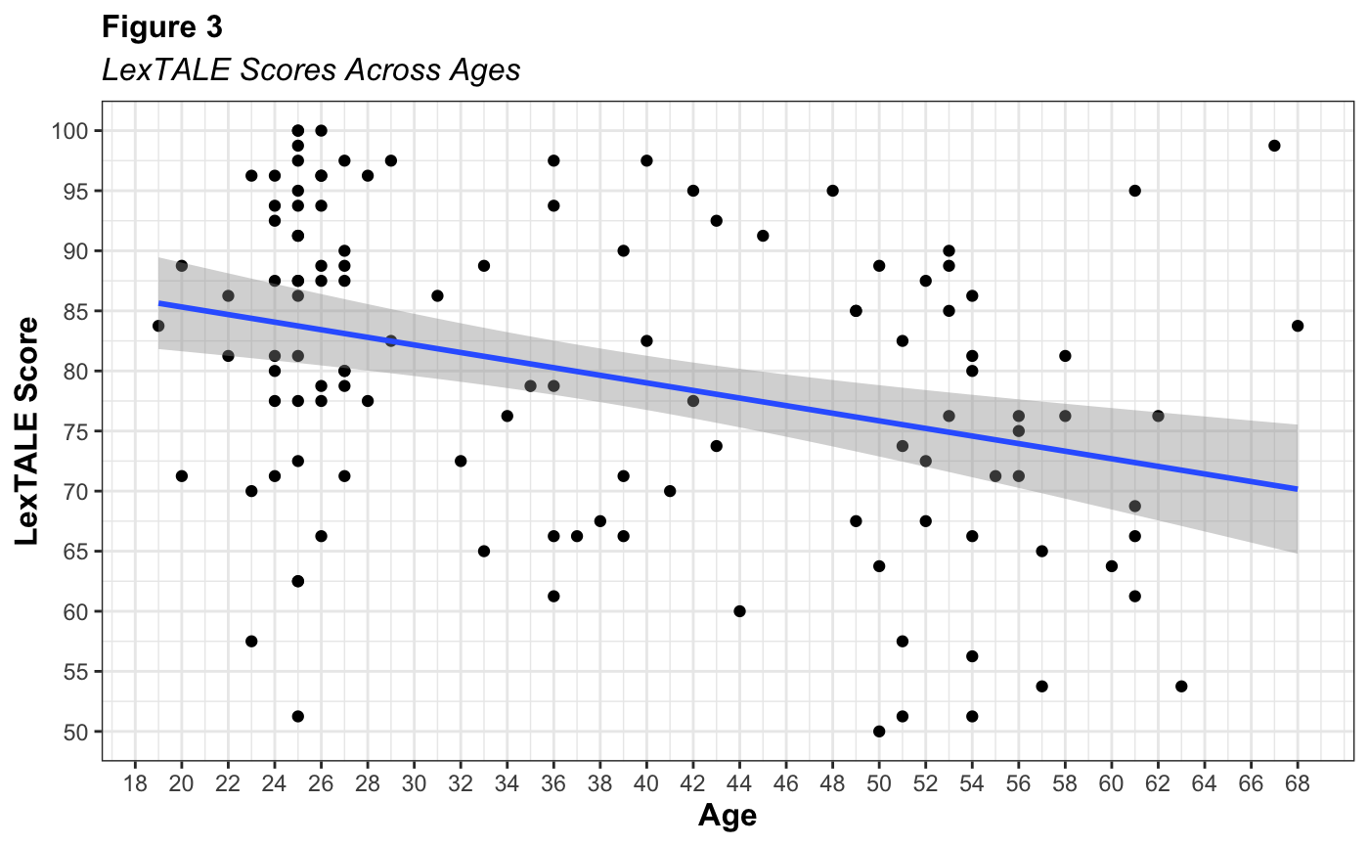
Exploratory Analysis
Post-hoc
Figure 1
Most around age 25
Sampling method
Social media
Linear regression
F(1, 118) = 14.74, p < .001, R² = 0.11, adj. R² = 0.10
People around my age

Slide 8
Discussion
Dylman & Champoux-Larsson, 2020
Language situation of the Faroe Islands
Lack of Faroese media
Future
Stratified sampling methods
Conclusion
Other languages
L1: Swedish
LX: Norwegian, English, French
Only French was significant
Danish and English

Slide 9
Thank you!
Jógvan Heindrikur R. Djurhuus
2463893D@student.gla.ac.uk
Supervisor: Dr. Wilhelmiina Toivo

